Slide 1
Clustering – Day 1
Notes:
Highlights: Introduce yourself and the session.
Key Takeaways: NA

Slide 2
Unsupervised Learning
Until now, there used to be a target variable.
Age | Income | Default
20 | 3000 | 1
30 | 4000 | 1
40 | 5000 | 0
50 | 6000 | 0
60 | 7000 | 0
Sometimes, we don’t want to predict a target variable.
Notes:
Duration: 10 minutes
Highlights:
Introduce the definition.
Identify the unique attributes.
Provide examples to elaborate the concept and non-examples to show the difference.
Use whiteboard if required.
Key Takeaways:
In what ways, learners can use the concept in real-life situations to provide solutions or solve problems.

Slide 3
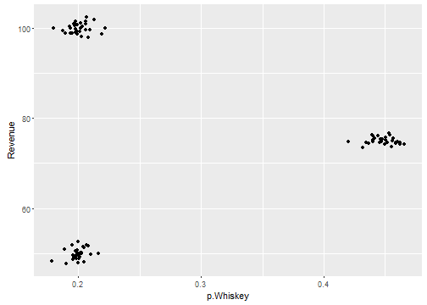
Unsupervised Learning
Store_id | P.Whisky | Revenue
1 | 0.40 | 80
2 | 0.20 | 60
3 | 0.35 | 40
4 | 0.22 | 90
5 | 0.45 | 75
Can you discover any groups/clusters in this data?
Notes:
Duration: 10 minutes
Highlights:
Introduce the definition.
Identify the unique attributes.
Provide examples to elaborate the concept and non-examples to show the difference.
Use whiteboard if required.
Key Takeaways:
In what ways, learners can use the concept in real-life situations to provide solutions or solve problems.

Slide 4
Unsupervised Learning
Store_id | P.Whisky | Revenue
1 | 0.40 | 80
2 | 0.20 | 60
3 | 0.35 | 40
4 | 0.22 | 90
5 | 0.45 | 75
Stores with Low proportion of whiskey sales
Stores with high revenue
Can you discover any groups/clusters in this data?
Notes:
Duration: 10 minutes
Highlights:
Introduce the definition.
Identify the unique attributes.
Provide examples to elaborate the concept and non-examples to show the difference.
Use whiteboard if required.
Key Takeaways:
In what ways, learners can use the concept in real-life situations to provide solutions or solve problems.

Slide 5
Unsupervised Learning
Store_id | P.Whisky | Revenue
1 | 0.40 | 80
2 | 0.20 | 60
3 | 0.35 | 40
4 | 0.22 | 90
5 | 0.45 | 75
Stores with Low proportion of whiskey sales
Stores with high revenue
Can you discover any groups/clusters in this data?
Notes:
Duration: 10 minutes
Highlights:
Introduce the definition.
Identify the unique attributes.
Provide examples to elaborate the concept and non-examples to show the difference.
Use whiteboard if required.
Key Takeaways:
In what ways, learners can use the concept in real-life situations to provide solutions or solve problems.

Slide 6
Unsupervised Learning
Store_id | P.Whisky | Revenue
1 | 0.40 | 80
2 | 0.20 | 60
3 | 0.35 | 40
4 | 0.22 | 90
5 | 0.45 | 75
Stores with Low proportion of whiskey sales
Stores with high revenue
Can you discover any groups/clusters in this data?
Notes:
Duration: 10 minutes
Highlights:
Introduce the definition.
Identify the unique attributes.
Provide examples to elaborate the concept and non-examples to show the difference.
Use whiteboard if required.
Key Takeaways:
In what ways, learners can use the concept in real-life situations to provide solutions or solve problems.

Slide 7
Unsupervised Learning
Store_id | P.Whisky | Revenue
1 | 0.40 | 80
2 | 0.20 | 60
3 | 0.35 | 40
4 | 0.22 | 90
5 | 0.45 | 75
Stores with Low proportion of whiskey sales
Stores with high revenue
Is this task like the supervised learning we’ve seen before?
Notes:
Duration: 10 minutes
Highlights:
Introduce the definition.
Identify the unique attributes.
Provide examples to elaborate the concept and non-examples to show the difference.
Use whiteboard if required.
Key Takeaways:
In what ways, learners can use the concept in real-life situations to provide solutions or solve problems.

Slide 8
Unsupervised Learning
Store_id | P.Whisky | Revenue
1 | 0.40 | 80
2 | 0.20 | 60
3 | 0.35 | 40
4 | 0.22 | 90
5 | 0.45 | 75
Stores with Low proportion of whiskey sales
Stores with high revenue
Is this task like the supervised learning we’ve seen before?
Is there any target variable we are trying to predict?
Notes:
Duration: 10 minutes
Highlights:
Introduce the definition.
Identify the unique attributes.
Provide examples to elaborate the concept and non-examples to show the difference.
Use whiteboard if required.
Key Takeaways:
In what ways, learners can use the concept in real-life situations to provide solutions or solve problems.

Slide 9

Unsupervised Learning: Class Exercise
Suppose from a web analytics platform we have data on:
Number of hits
Duration of stays on a web page
Number of pages visited
Amount of money spent
Discuss what type of segments you can discover?
Notes:
Duration: 10 minutes
Highlights:
Introduce the definition.
Identify the unique attributes.
Provide examples to elaborate the concept and non-examples to show the difference.
Use whiteboard if required.
Key Takeaways:
In what ways, learners can use the concept in real-life situations to provide solutions or solve problems.

Slide 10
Unsupervised Learning: Class Exercise
Suppose from a web analytics platform we have data on:
Number of hits
Duration of stays on a web page
Number of pages visited
Amount of money spent
Many categories can be potentially discovered
Group of people with a high hit rate, a small amount of money spent
Group of people with short duration stay, a large amount of money spent
And many more
Notes:
Duration: 10 minutes
Highlights:
Introduce the definition.
Identify the unique attributes.
Provide examples to elaborate the concept and non-examples to show the difference.
Use whiteboard if required.
Key Takeaways:
In what ways, learners can use the concept in real-life situations to provide solutions or solve problems.

Slide 11
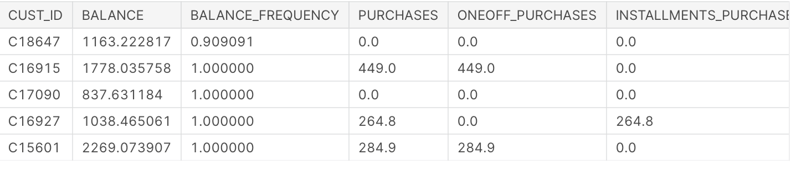
Unsupervised Learning: Class Exercise
Look at this data. Are there any business-relevant segments you can discover from this dataset?
Notes:
Duration: 10 minutes
Highlights:
Introduce the definition.
Identify the unique attributes.
Provide examples to elaborate the concept and non-examples to show the difference.
Use whiteboard if required.
Key Takeaways:
In what ways, learners can use the concept in real-life situations to provide solutions or solve problems.

Slide 12
Unsupervised Learning: Class Exercise
Look at this data. Are there any business-relevant segments you can discover from this dataset?
Group of customers with high balance but meager purchase amounts (Potential for upsell, offers)
Group of customers with low balance but very high purchase amounts (Potentially risky customers)
Notes:
Duration: 10 minutes
Highlights:
Introduce the definition.
Identify the unique attributes.
Provide examples to elaborate the concept and non-examples to show the difference.
Use whiteboard if required.
Key Takeaways:
In what ways, learners can use the concept in real-life situations to provide solutions or solve problems.

Slide 13
Need for Clustering Algorithm
How many groups?
How did you find it?
What if you need segments by four variables?
Store_id | P.Whisky | Revenue
1 | 0.40 | 80
2 | 0.20 | 60
3 | 0.35 | 40
4 | 0.22 | 90
5 | 0.45 | 75
Notes:
Duration: 10 minutes
Highlights:
Introduce the definition.
Identify the unique attributes.
Provide examples to elaborate the concept and non-examples to show the difference.
Use whiteboard if required.
Key Takeaways:
In what ways, learners can use the concept in real-life situations to provide solutions or solve problems.

Slide 14
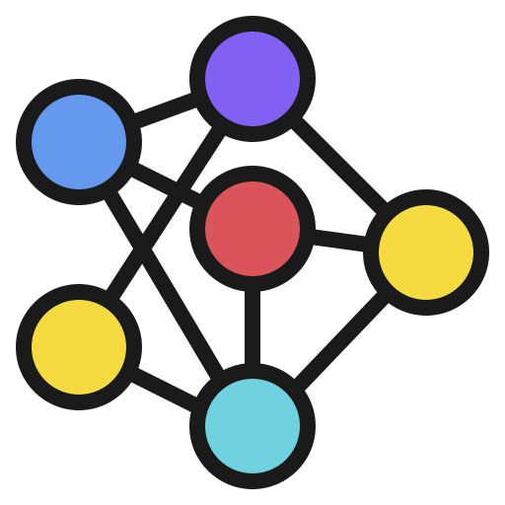
Need for Clustering Algorithm
Cluster: How? Visualize?
What if eight variables are used that we need to create clusters?
We need an algorithm
KMeans
Notes:
Duration: 10 minutes
Highlights:
Introduce the definition.
Identify the unique attributes.
Provide examples to elaborate the concept and non-examples to show the difference.
Use whiteboard if required.
Key Takeaways:
In what ways, learners can use the concept in real-life situations to provide solutions or solve problems.

Slide 15
Clustering: KMeans
KMeans is an iterative algorithm.
The “K” in KMeans, stands for the number of clusters to be found in data; it’s a user-supplied parameter.
The output of the KMeans algorithm is the cluster label for each row of data.
Notes:
Duration: 10 minutes
Highlights:
Introduce the definition.
Identify the unique attributes.
Provide examples to elaborate the concept and non-examples to show the difference.
Use whiteboard if required.
Key Takeaways:
In what ways, learners can use the concept in real-life situations to provide solutions or solve problems.

Slide 16
Clustering: KMeans
3
P.Whisky | Revenue | Label
0.40 | 80 | 1
0.20 | 60 | 2
0.35 | 40 | 2
0.22 | 90 | 3
0.45 | 75 | 1
1
2
Notes:
Duration: 10 minutes
Highlights:
Introduce the definition.
Identify the unique attributes.
Provide examples to elaborate the concept and non-examples to show the difference.
Use whiteboard if required.
Key Takeaways:
In what ways, learners can use the concept in real-life situations to provide solutions or solve problems.

Slide 17
Clustering: KMeans
Algorithm
Initialize “K” cluster centers randomly
Find the distance of each point from the “K” cluster centers.
Based on the proximity of each point from the “K” cluster centers, we give cluster labels to each data point.
After the clusters are formed, we re-compute the cluster centers.
Repeat a), b), and c) till convergence (till no data point changes cluster membership in succeeding iterations).
Notes:
Duration: 10 minutes
Highlights:
Introduce the definition.
Identify the unique attributes.
Provide examples to elaborate the concept and non-examples to show the difference.
Use whiteboard if required.
Key Takeaways:
In what ways, learners can use the concept in real-life situations to provide solutions or solve problems.

Slide 18
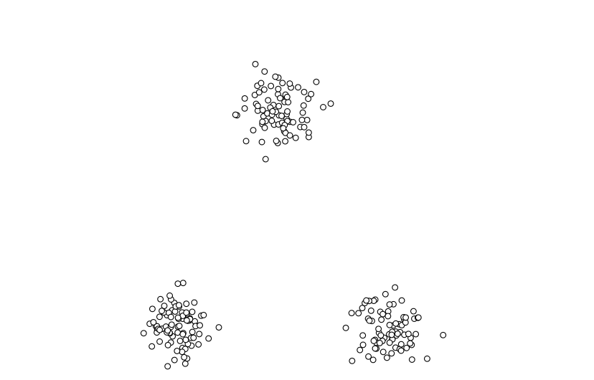
Clustering: KMeans
There are 3 data clusters, K = 3.
Notes:
Duration: 10 minutes
Highlights:
Introduce the definition.
Identify the unique attributes.
Provide examples to elaborate the concept and non-examples to show the difference.
Use whiteboard if required.
Key Takeaways:
In what ways, learners can use the concept in real-life situations to provide solutions or solve problems.

Slide 19
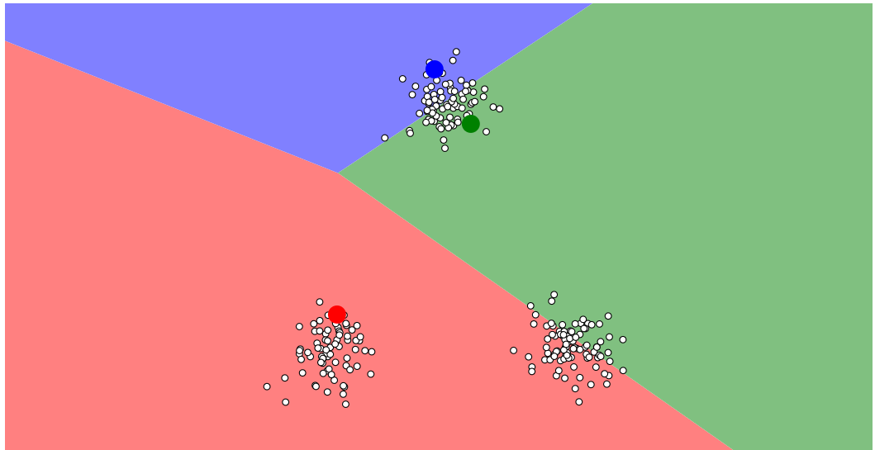
Clustering: KMeans
Randomly assign 3 points as cluster centers.
Notes:
Duration: 10 minutes
Highlights:
Introduce the definition.
Identify the unique attributes.
Provide examples to elaborate the concept and non-examples to show the difference.
Use whiteboard if required.
Key Takeaways:
In what ways, learners can use the concept in real-life situations to provide solutions or solve problems.

Slide 20
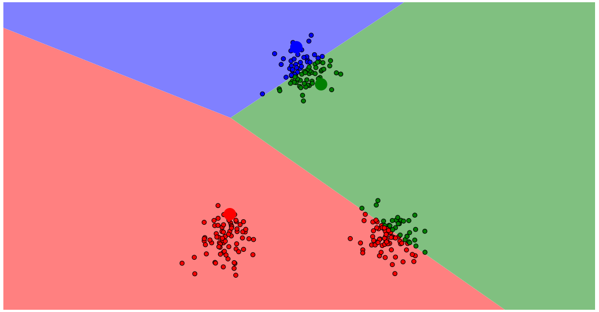
Clustering: KMeans
Compute the distances of each point from each of the cluster centers and assign cluster labels.
Notes:
Duration: 10 minutes
Highlights:
Introduce the definition.
Identify the unique attributes.
Provide examples to elaborate the concept and non-examples to show the difference.
Use whiteboard if required.
Key Takeaways:
In what ways, learners can use the concept in real-life situations to provide solutions or solve problems.

Slide 21
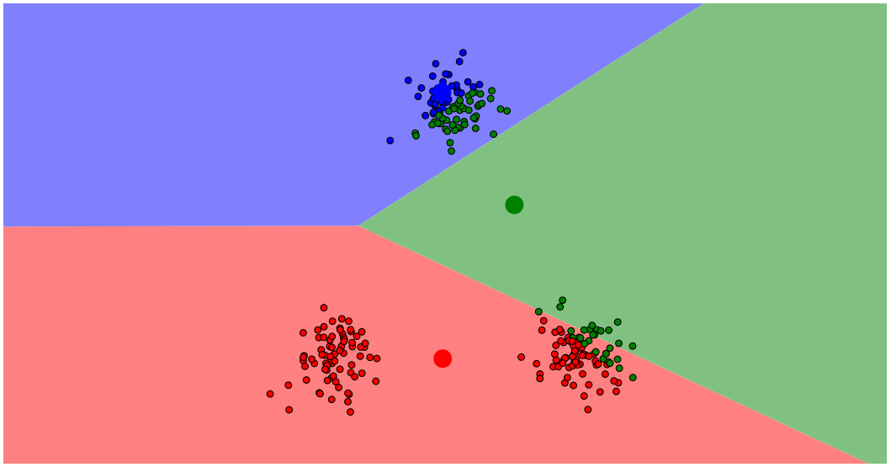
Clustering: KMeans
Re-compute cluster centers.
Notes:
Duration: 10 minutes
Highlights:
Introduce the definition.
Identify the unique attributes.
Provide examples to elaborate the concept and non-examples to show the difference.
Use whiteboard if required.
Key Takeaways:
In what ways, learners can use the concept in real-life situations to provide solutions or solve problems.

Slide 22
Clustering: KMeans
Compute distances of each point from each of the cluster centers and assign cluster labels
Notes:
Duration: 10 minutes
Highlights:
Introduce the definition.
Identify the unique attributes.
Provide examples to elaborate the concept and non-examples to show the difference.
Use whiteboard if required.
Key Takeaways:
In what ways, learners can use the concept in real-life situations to provide solutions or solve problems.

Slide 23
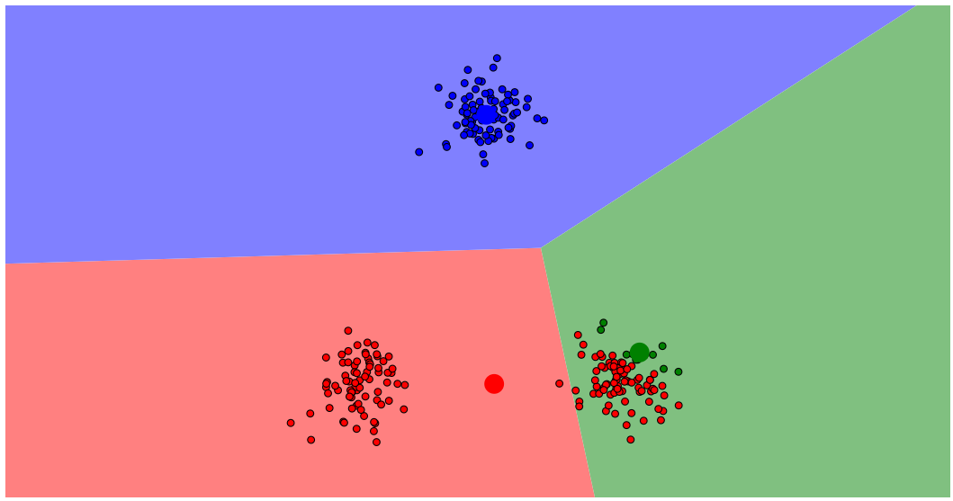
Clustering: KMeans
Recompute cluster centers.
Notes:
Duration: 10 minutes
Highlights:
Introduce the definition.
Identify the unique attributes.
Provide examples to elaborate the concept and non-examples to show the difference.
Use whiteboard if required.
Key Takeaways:
In what ways, learners can use the concept in real-life situations to provide solutions or solve problems.

Slide 24
Clustering: KMeans
Compute the distances of each point from each of the cluster centers and assign cluster labels.
Notes:
Duration: 10 minutes
Highlights:
Introduce the definition.
Identify the unique attributes.
Provide examples to elaborate the concept and non-examples to show the difference.
Use whiteboard if required.
Key Takeaways:
In what ways, learners can use the concept in real-life situations to provide solutions or solve problems.

Slide 25
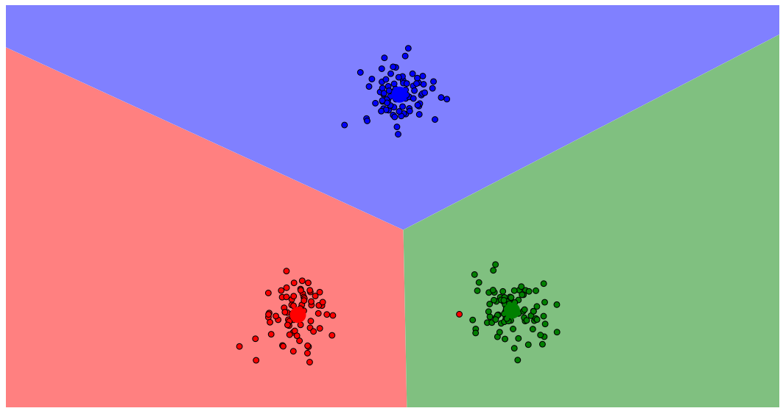
Clustering: KMeans
Recompute cluster centers.
Notes:
Duration: 10 minutes
Highlights:
Introduce the definition.
Identify the unique attributes.
Provide examples to elaborate the concept and non-examples to show the difference.
Use whiteboard if required.
Key Takeaways:
In what ways, learners can use the concept in real-life situations to provide solutions or solve problems.

Slide 26
Clustering: KMeans
Compute the distances of each point from each of the cluster centers and assign cluster labels.
Notes:
Duration: 10 minutes
Highlights:
Introduce the definition.
Identify the unique attributes.
Provide examples to elaborate the concept and non-examples to show the difference.
Use whiteboard if required.
Key Takeaways:
In what ways, learners can use the concept in real-life situations to provide solutions or solve problems.

Slide 27

Clustering: KMeans
Demonstrate Numerical Example Clustering.xlsx
Please go through the excel sheet before the class.
Notes:
Note to instructor: Explaining this will take time, please go through the excel sheet before the class. Note to instructor: Explaining this will take time, please go through the excel sheet before the class.

Slide 28
Clustering Class Exercise
Age | Weight
30 | 67
35 | 70
25 | 64
23 | 62
Center | X (Age) | Y (Weight)
C1 | 32 | 68
C2 | 24 | 63
Find out which clusters each row will belong to. Compute the distance of each point from the centers and then decide.

Slide 29
Clustering Class Exercise
Age | Weight
30 | 67
35 | 70
25 | 64
23 | 62
Center | X (Age) | Y (Weight)
C1 | 32 | 68
C2 | 24 | 63
Find out which clusters each row will belong to. Compute the distance of each point from the centers and then decide.
Solution: See Numerical Example Clustering.xlsx, sheet named Class Exercise.

Slide 30
Clustering: KMeans
Once we intuitively understand how Kmeans work, there are some peculiarities about Kmeans that we need to keep in mind:
Data Level:
Only numeric data can be fed to a Kmeans algorithm.
Data should be scaled
Algorithm Level:
How to find out what could be a good value of “K”?

Slide 31
Clustering: Kmeans
Revenue | Size (Sq ft) | Footfall | City
4000 | 1000 | 80 | Blr
3000 | 1200 | 90 | Blr
8000 | 1400 | 100 | Chennai
9000 | 900 | 200 | Blr
2000 | 1234 | 324 | Chennai
Revenue | Size (Sq ft) | Footfall | City_Blr | City_Ch
4000 | 1000 | 80 | 1 | 0
3000 | 1200 | 90 | 1 | 0
8000 | 1400 | 100 | 0 | 1
9000 | 900 | 200 | 1 | 0
2000 | 1234 | 324 | 0 | 1

Slide 32
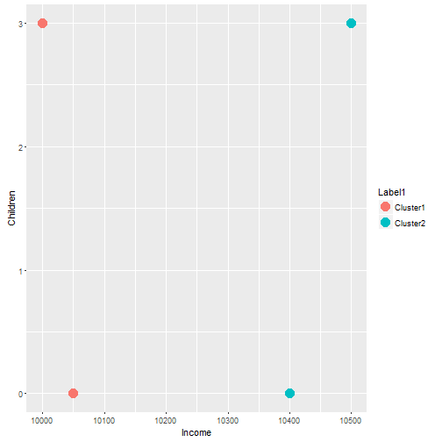
Clustering: Kmeans, Data Should be Scaled
Income | Children
10050 | 0
10050 | 2
10400 | 0
10500 | 2

Slide 33
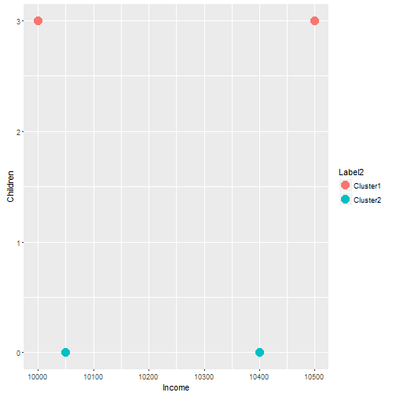
Clustering: Kmeans, Data Should be Scaled
Income | Children
10050 | 0
10050 | 2
10400 | 0
10500 | 2

Slide 34

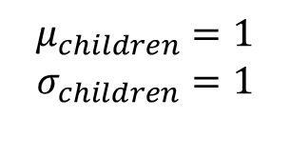
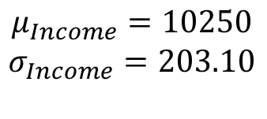
Clustering: Kmeans, Data Should be Scaled
Income | Children
10050 | 0
10050 | 2
10400 | 0
10500 | 2
Income | Children
-0.98 | -1
-0.98 | 1
0.73 | -1
1.73 | 1
$$Z_{i}=(x_{i}−μ)/σ$$
$$μ_{Income}=10250$$
$$σ_{Income}=203.10$$
$$μ_{children}=1$$
$$σ_{children}=1$$
Similar Scale
Z scores are not the only way to standardize data; one can use min max scaler link and absolute scaler link.

Slide 35
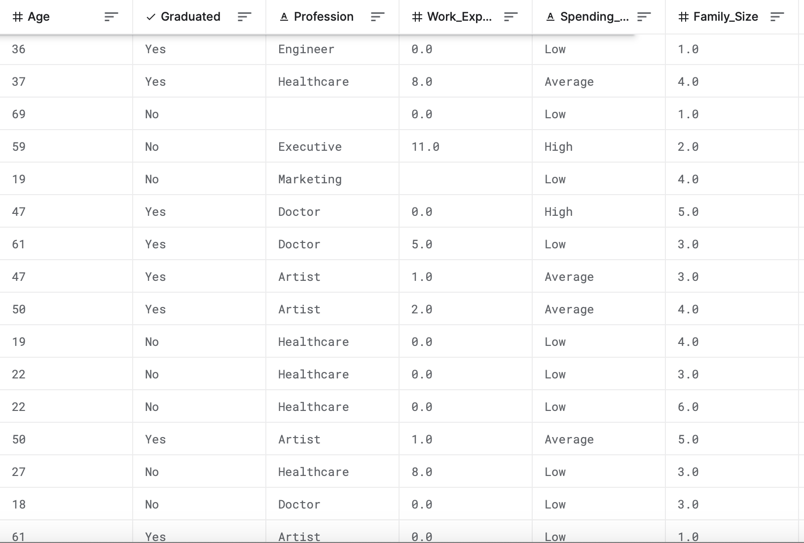
Clustering Class Exercise
Look at the data and discuss what kind of transformations you will need to do for the variables present here.

Slide 36
Clustering Class Exercise
Look at the data and discuss what kind of transformations you will need to do for the variables present here.
Age: Standardize
Graduated: Either drop or create a dummy
Profession: Either drop 9 or create a dummy
Work Experience: Standardize
Spending: Either drop or create a dummy
Family Size: Standardize

Slide 37

Clustering Kmeans: Python Demo
Github link to demo link

